Slide 1
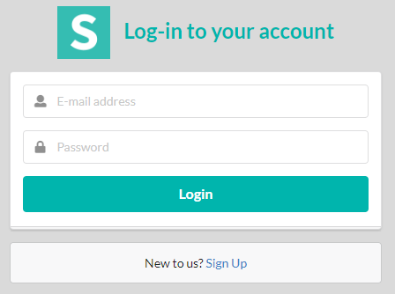
HoneyDew
H
d

Slide 2
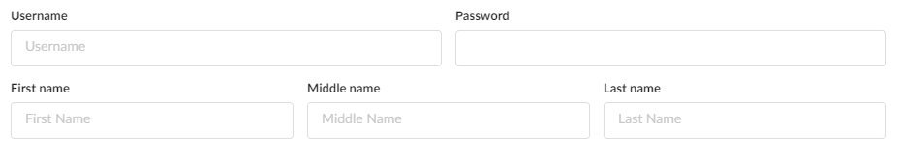
Basic
Registration page
And
Link account request
H
d
External Account
userID
App Accnt #
App Password
App Name

Slide 3
Additional Members
Basic information required for additional members
H
d
Additional Member
First Name
Last Name
userID
password
Additional Member
First Name
Last Name
userID
password
Additional Member
First Name
Last Name
userID
password

Slide 4
H
d
Grocery List
Chores
Reminders
First Name

Slide 5
Basic grocery list
Automatically synced with linked Walmart account
Will be reorganized when list is synced
Organized according to the website layout of store
H
d
Grocery List
Item | Dty | Location
Eggs | 1 | J2
Milk | 1 | A4
Cereal | 1 | B3

Slide 6
Chores List
Will be assigning base on who’s been added as a
Member of the account by the primary or secondary
user. Multiple members can be added.
Updates are provided to main user as tasks are completed.
Able to assign frequency of tasks. Daily, Weekly or Monthly recurrence.
H
d
Chore List
Assigned to:
Big Brother:
Make bed
Take out Trash
Vacuum Loft
Daily
Weekly
Monthly

Slide 7
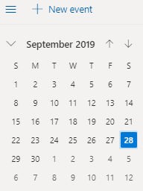
Reminders
Set reminders
Notify all members
Able to sync with Alexa, calendar applications
Provide notification and set up recurrence
H
d
Reminders
Add Reminder
Assign Reminder
Sync with Alexa

Slide 8
Application set up
Here’s a simply application set up
Able to view through personal device
HoneyDew
List
Shopping
Chores
Reminder

Slide 9
Grocery List
Grocery
List
Jalapeno
Milk
Eggs
Bacon
Orange Juice
Steak
Chicken
Etc…..
Linked to WalMart (OrangePark)
Add Member
Random Ad

Slide 10
Reminders
Upcoming Reminders
Reminder:
Pick up suit/Location/Time
Bring things to work
PTA mtg/school/time
Sync with Calendar
Add Member
View Calendar
Random Ad

Slide 11
Chores layout
Chores
Daily
Weekly
Monthly
Add Member
Update Status

Slide 12
NeverEnding Chores
BigBrother
Daily
Make Bed
Take Trash
Sweep
Homework
Weekly
Trash
Recycle
Field day
PT
Update Status

Slide 13



Chore layout
Through personal device, members are able to provide updates as tasks are complete to the main users.
Updates are automatically pushed to all members.
BigBrother
Make Bed
Take Trash
Sweep
HomeWork
**simple layout of my planned project
Update Status

